Slide 1
Controllability & Observability

Slide 2
We learn:
Controllability
Observability

Slide 3
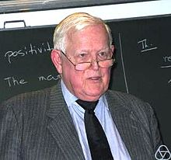
Controllability and observability
Controllability and observability represent two major concepts of modern control system theory.
These concepts were introduced by R.Kalman in 1960.
In a nutshell:
Controllability:
In order to be able to do whatever we want with the given dynamic system under control input, the system must be controllable.
Observability:
In order to see what is going on inside the system under observation, the system must be observable.

Slide 4
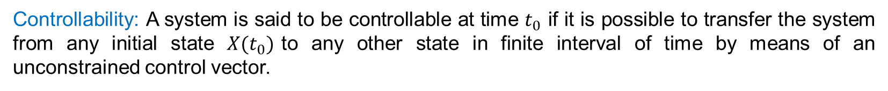
Controllability and observability formal definition:
Controllability: A system is said to be controllable at time $t_{0}$ if it is possible to transfer the system from any initial state $X(t_{0})$to any other state in finite interval of time by means of an unconstrained control vector.
A system is completely controllable if the initial state of the system is transferred to any particular state, in a finite time duration, when a controlled input is provided to it.
Observability: A system is said to be observable at time $t_{0}$ if it is possible to determine the state $X(t_{0})$of the system from the observation of the output over a finite time interval.
Observability of a control system is the ability of the system to determine the internal states of the system by observing the output in a finite time interval when input is provided to the system.

Slide 5
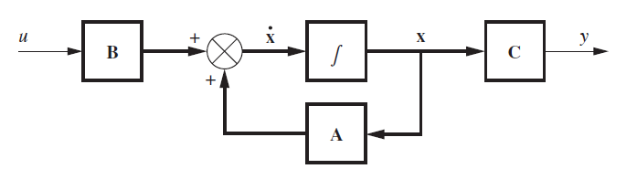


controllability
Consider the system:
$${\dot{X}}_{n×1}=A_{n×n}X_{n×1}+B_{n×1}u$$
Open-loop system (plant)
$X :$ state vector $∈R^{n}$
$u :$ control signal $(scalar)$
$A :$ n×n matrix
B : n×1 matrix

Slide 6

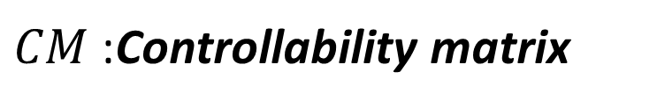
Controllability:
$${\dot{X}}_{n×1}=A_{n×n}X_{n×1}+B_{n×1}u$$
Is said to be state controllable at $t=t_{0}$ if it is possible to construct an unconstrained control signal that will transfer an initial state to any final state in a finite tie interval $t_{0}≤t≤t_{1}$
If every state is controllable, then the system is said to be completely state controllable.
How to check controllability:
If the system is completely state controllable, then given any initial state x(0), the rank of the n×n matrix CM must be n.
$$CM={\left[\begin{matrix}B & AB & A^{2}B & ⋯ & A^{n−1}B\end{matrix}\right]}_{n×n}$$
$CM$:Controllability matrix
The rank of CM equals the number of linearly independent rows or columns. The rank can be found by finding the highest-order square submatrix that is nonsingular.

Slide 7

Example 1:
Is the system controllable?

Slide 8
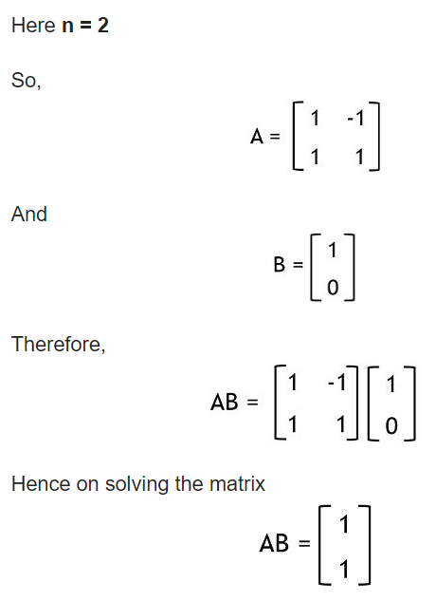
Solution.
$$CM={\left[\begin{matrix}B & AB\end{matrix}\right]}_{2×2}=\left[\begin{matrix}1 & 1 \\ 0 & 1\end{matrix}\right]$$
$$\left|CM\right|=1≠0$$
Here determinant of the CM matrix is non-zero.
Also, the rank of CM, n is 2.
So, the system is controllable

Slide 9

Example 2:
Is the system controllable?

Slide 10
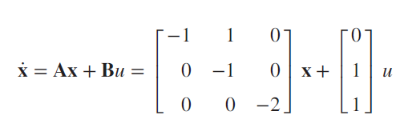
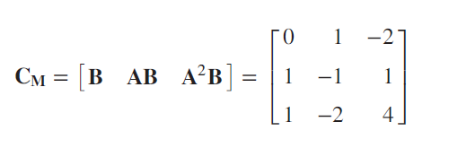
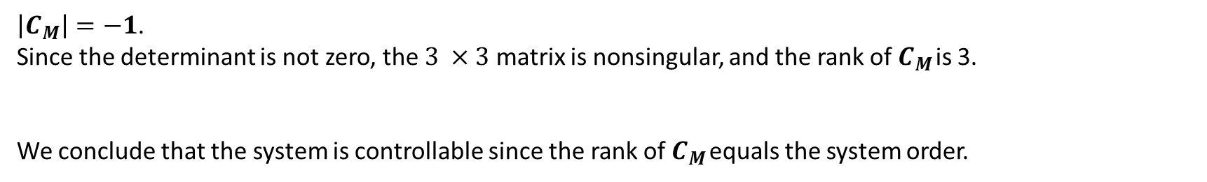
Ex7.
$\left|C_{M}\right|=−1$.
Since the determinant is not zero, the $3 ×3$ matrix is nonsingular, and the rank of $C_{M}$ is 3.
We conclude that the system is controllable since the rank of $C_{M}$ equals the system order.

Slide 11
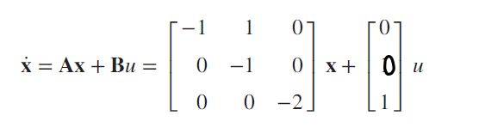
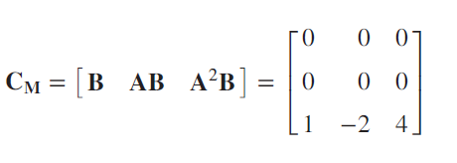
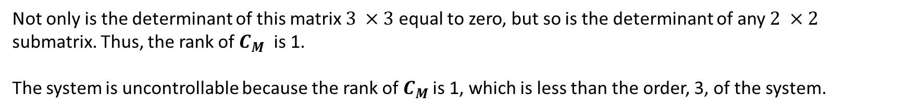
Ex8.
Not only is the determinant of this matrix $3 ×3$equal to zero, but so is the determinant of any $2 ×2$
submatrix. Thus, the rank of $C_{M}$ is 1.
The system is uncontrollable because the rank of $C_{M}$ is 1, which is less than the order, 3, of the system.

Slide 12
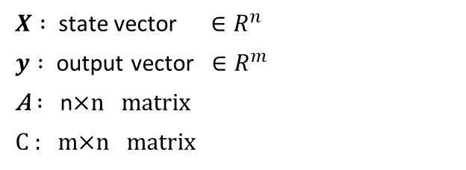

Observability:
Consider the unforced system described by the equations
$${\dot{X}}_{n×1}=A_{n×n}X_{n×1}$$
$$y=CX$$
$X :$ state vector $∈R^{n}$
$y :$ output vector $∈R^{m}$
A $:$ n×n matrix
C : m×n matrix

Slide 13
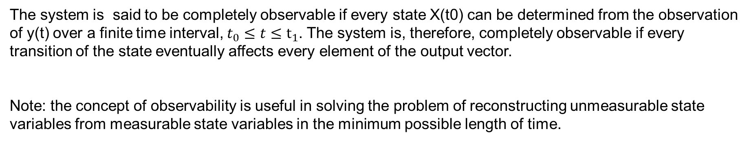
observability
The system is said to be completely observable if every state X(t0) can be determined from the observation of y(t) over a finite time interval, $t_{0}≤t≤t_{1}$. The system is, therefore, completely observable if every transition of the state eventually affects every element of the output vector.
Note: the concept of observability is useful in solving the problem of reconstructing unmeasurable state variables from measurable state variables in the minimum possible length of time.
How to check observability:
the system is said to be completely observable only under the condition that the rank of the matrix OM is n.
$$OM={\left[\begin{matrix}C^{T} & A^{T}C^{T} & {\left(A^{T}\right)}^{2}C^{T} & ⋯ & {\left(A^{T}\right)}^{n−1}C^{T}\end{matrix}\right]}_{mn×n}$$

Slide 14
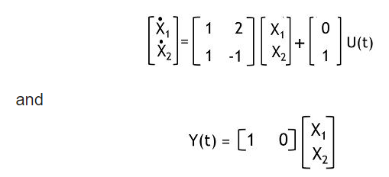
Example 3.
The system is observable or not?

Slide 15
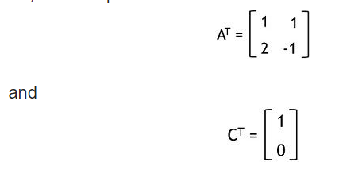
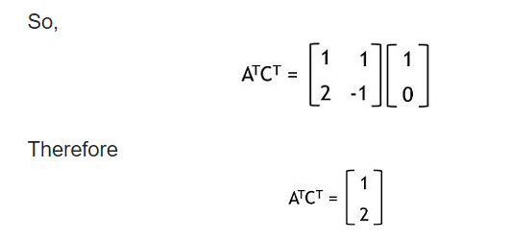
Solution.
$$OM={\left[\begin{matrix}C^{T} & A^{T}C^{T}\end{matrix}\right]}_{2×2}=\left[\begin{matrix}1 & 1 \\ 0 & 2\end{matrix}\right]$$
$$\left|OM\right|=2≠0$$
$$OM={\left[\begin{matrix}C^{T} & A^{T}C^{T}\end{matrix}\right]}_{2×2}$$
As it is clear that the determinant achieved here is 2, thus is non-zero. Also, the rank here is 2

Slide 16
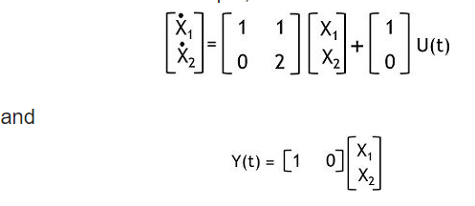
Exampel 4.
The system is observable or not?

Slide 17
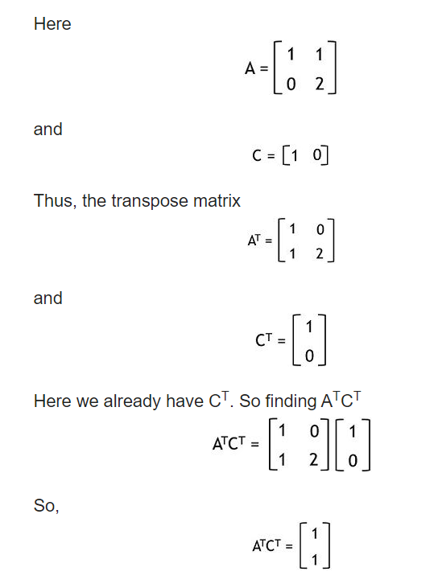
Solution:
$$OM={\left[\begin{matrix}C^{T} & A^{T}C^{T}\end{matrix}\right]}_{2×2}=\left[\begin{matrix}1 & 1 \\ 0 & 1\end{matrix}\right]$$
$$\left|OM\right|=1≠0$$
As it is clear that the determinant achieved here is 1, thus is non-zero. Also, the rank here is 2

Slide 18

Matlab commands for the computation of controllability and observability matrices.
CONT=ctrb(A,B)
OBSER=obsv(A,C)
$$\dot{X}=AX+Bu$$
$$y=CX+Du$$
The rank of CONT and OBSER respectively determine the controllability and observability of the system.
If rank(CONT) or rank(OBSER) is less than n, where n is the order of the system, the system is not controllable or not observable respectively.
In terms of transfer functions, if the rank(CONT) or rank(OBSER) is less than n, there is a cancellation of terms in the numerator and denominator of the transfer function.
Whether or not the cancellation occurs between the numerator and denominator of the transfer function, we may use the command minreal(sys) to see if we get a simplified transfer function.

Slide 19




Example 5.
Examine the controllability and observability of the system defined by:
$$\dot{X}=AX+Bu$$
$$y=CX$$
where
$$A=\left[\begin{matrix}0 & 1 & 0 \\ 0 & 0 & 1 \\ −6 & −11 & −6\end{matrix}\right]$$
$$B=\left[\begin{matrix}0 \\ 0 \\ 1\end{matrix}\right]$$
$$C=\left[\begin{matrix}5 & 6 & 1\end{matrix}\right]$$

Slide 20
CONT =
0 0 1
0 1 -6
1 -6 25
ans =
3
OBSER =
5 6 1
-6 -6 0
0 -6 -6
ans =
2
A=[0 1 0;0 0 1;-6 -11 -6];
B=[0;0;1];
C=[5 6 1];
D=0;
CONT=ctrb(A,B)
rank(CONT)
OBSER=obsv(A,C)
rank(OBSER)

Slide 21
This system is controllable, but not observable.
This suggest that there is a cancellation of terms in the numerator and denominator of the transfer function
sys=tf(num,den)
num =
0 1 6 5
den =
1.0000 6.0000 11.0000 6.0000
sys =
s^2 + 6 s + 5
----------------------
s^3 + 6 s^2 + 11 s + 6
Continuous-time transfer function.
[num,den]=ss2tf(A,B,C,D)
sys=tf(num,den)

Slide 22
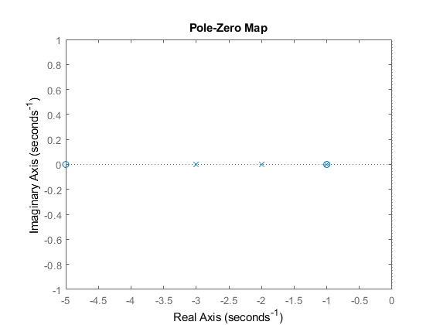
pzmap(sys)

Slide 23
minreal
Minimal realization or pole-zero cancellation
sys_min =
s + 5
-------------
s^2 + 5 s + 6
Continuous-time transfer function.
sys_min=minreal(sys)
(s+1) terms in the numerator and denominator of the transfer function are cancelled.

Slide 24

Example 6.
Consider the system defined by.
$$\left[\begin{aligned}{\dot{x}}_{1} \\ {\dot{x}}_{2}\end{aligned}\right]=\left[\begin{matrix}1 & 0 \\ 0 & −1\end{matrix}\right]\left[\begin{matrix}x_{1} \\ x_{2}\end{matrix}\right]+\left[\begin{matrix}1 \\ 0\end{matrix}\right]u$$
$y=\left[\begin{matrix}1 & 1\end{matrix}\right]$ $\left[\begin{matrix}x_{1} \\ x_{2}\end{matrix}\right]+0u$

Slide 25
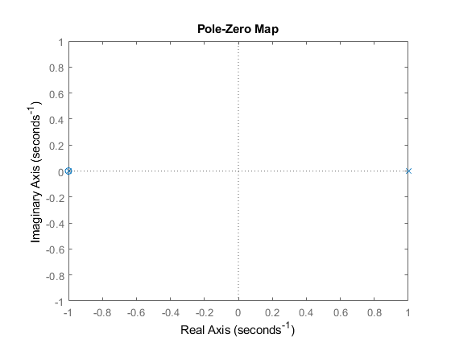
CONT =
1 1
0 0
ans =
1
OBSER =
1 1
1 -1
ans =
2
num =
0 1 1
den =
1 0 -1
sys =
s + 1
-------
s^2 - 1
Continuous-time transfer function.
sys_min =
1
-----
s - 1
Continuous-time transfer function.
A=[1 0;0 -1];
B=[1;0];
C=[1 1];
D=0;
CONT=ctrb(A,B)
rank(CONT)
OBSER=obsv(A,C)
rank(OBSER)
[num,den]=ss2tf(A,B,C,D)
sys=tf(num,den)
pzmap(sys)
sys_min=minreal(sys)

Slide 26
